Slide 1
Tutorial 6: A Presentation on the run simulation with Flow Model FM
Author
Md. Nazmus Sanib Chowdhury
Scientific Officer
Hydrography and Oceanography
Celestial Tech Limited

Slide 2
Objective
In this tutorial we will run a 2D Hydrodynamic simulation with the MIKE Zero software. On the way, we will use the mesh file and tide prediction created in the tutorial 4 and tutorial 5 respectively.

Slide 3
First Step
At first open the MIKE Zero.
Press CTRL+N from your computer’s keyboard
“New File” dialog box will be opened.

Slide 4
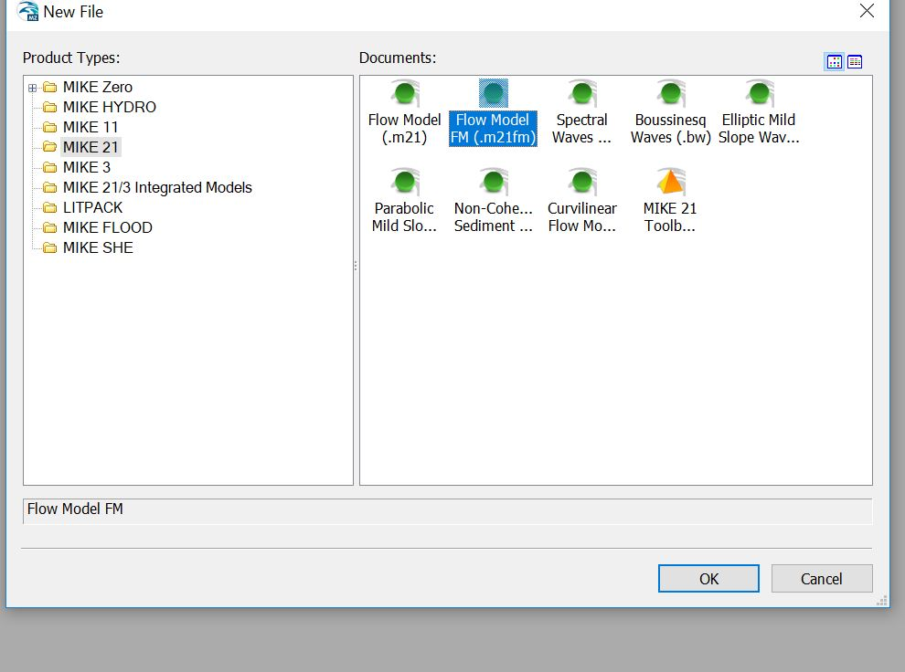

Slide 5
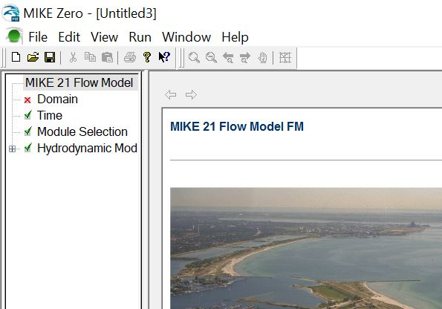
The windows for the “Flow model FM (.m21fm)” will be appeared.
There is a tree view options in the right.
Click on the “Domain” option from the tree view.

Slide 6
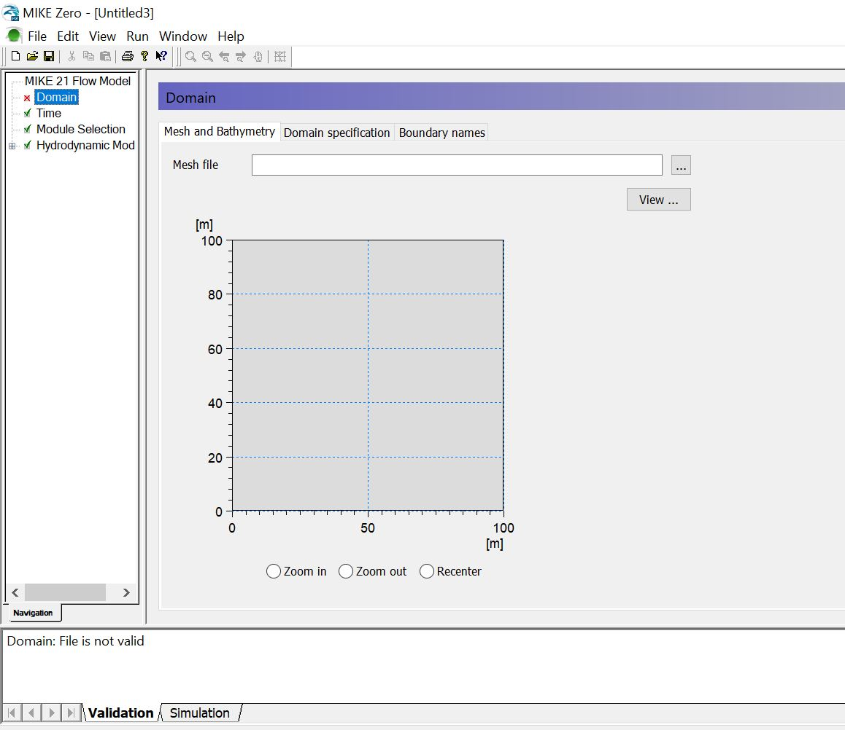
The “Domain” window will be appeared.
Click on the three dots (…) right to the “Mesh file”.

Slide 7
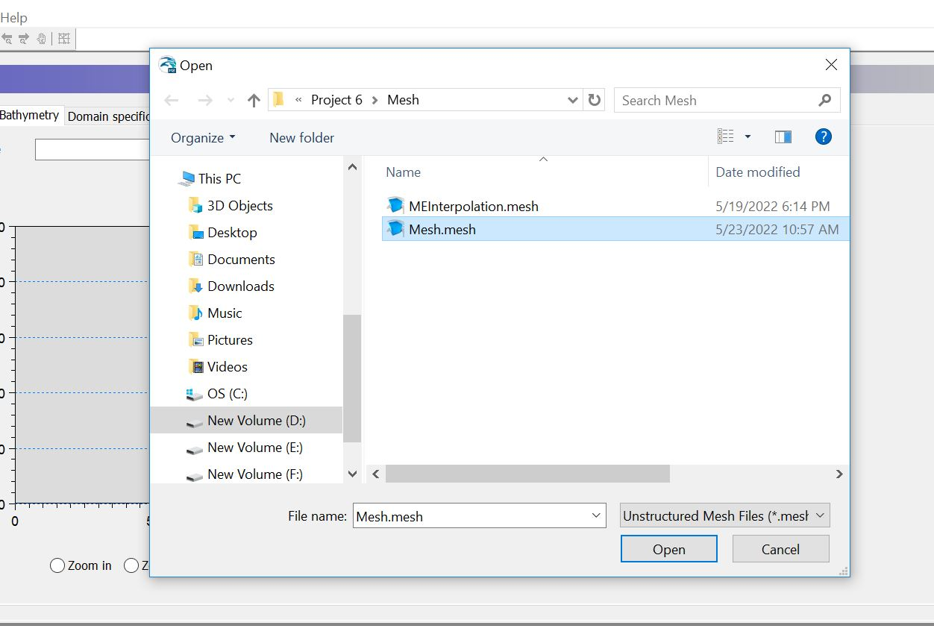
The “Open” dialog box will be appeared.
Select the mesh file you created in the mesh generation tutorial.
Click on the
Open” button.

Slide 8
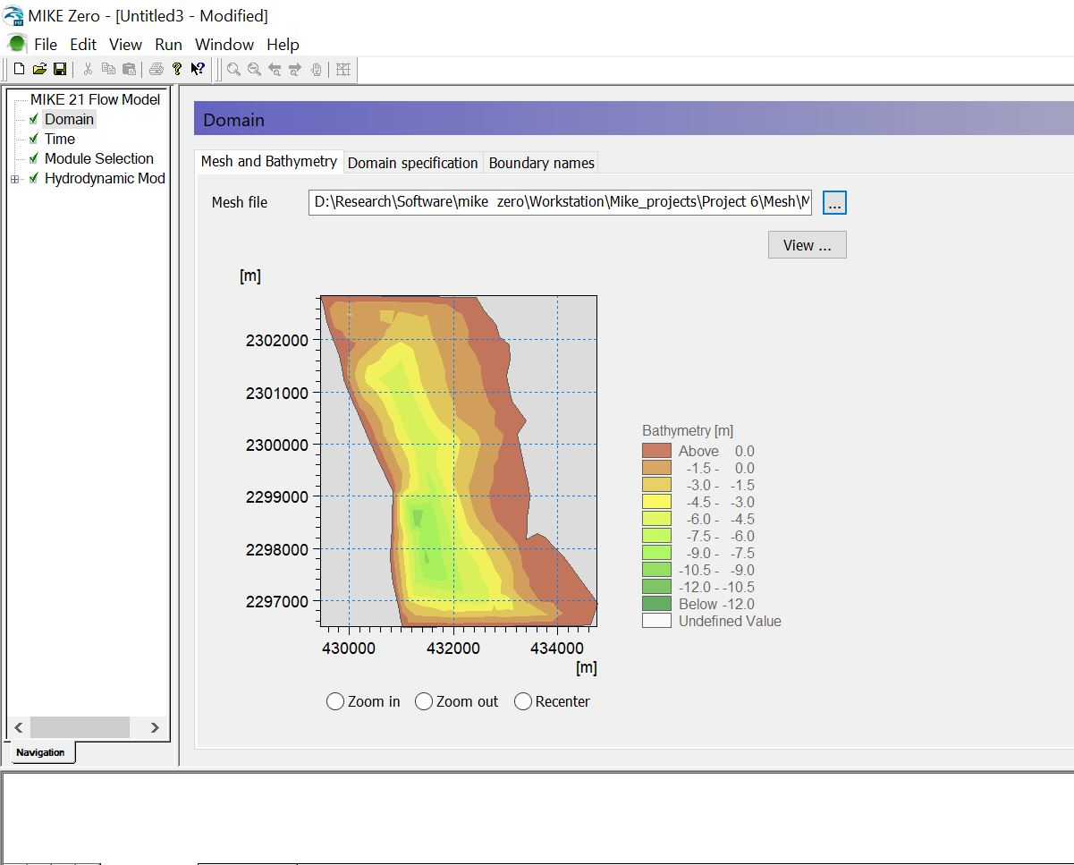
The mesh file is opened.
Click on the “Domain specification” tab (top of the “Domain” window)
Drag the mouse icon over this red box to get the boundary code in the north. The Code is 2.
Drag the mouse icon over this red box to get the boundary code in the South. The Code is 3.

Slide 9
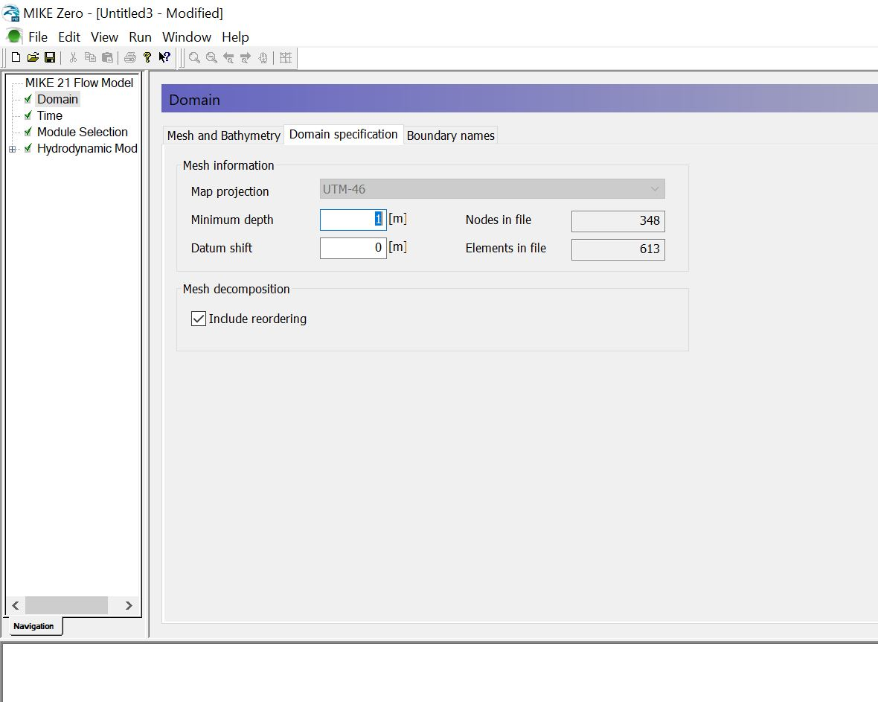
Check if the Map projection is set to UTM-46.
Click on the “Boundary names” tab.

Slide 10
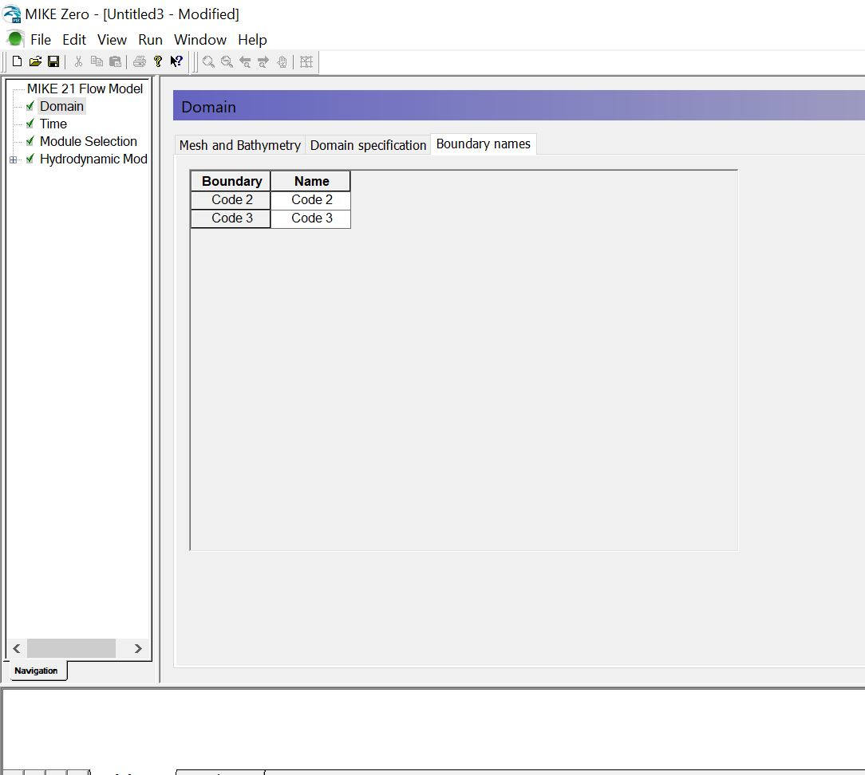
As per slide no 8, the code 2 is referred to the North and Code 3 referred to the South

Slide 11
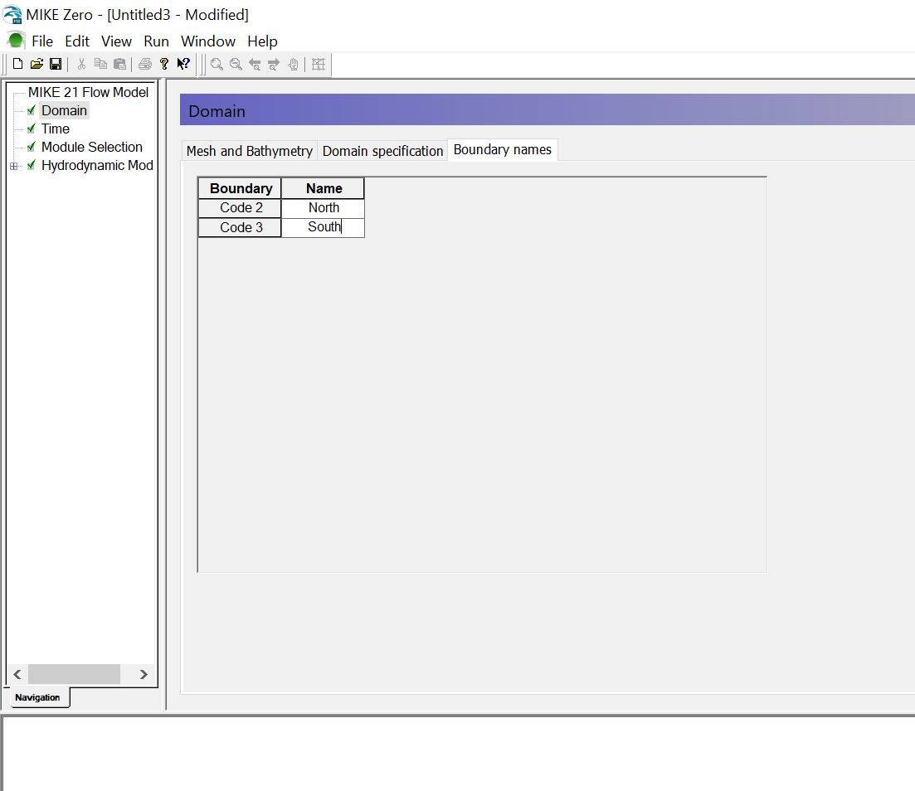
Rename the Code 2 and Code 3 as “North” and “South” respectively.
Now, “North” and “South” are the two water boundary name.

Slide 12
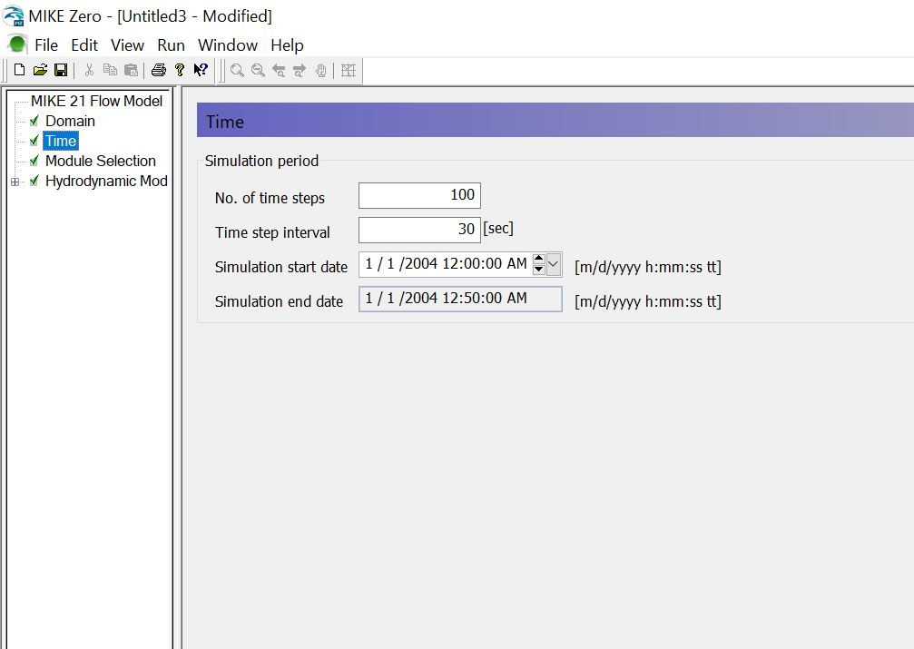
Move to the “Time” tab from the tree view.

Slide 13
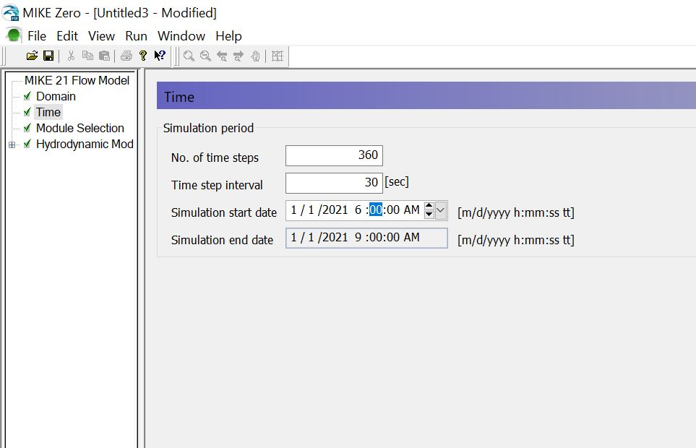
If “Time step interval” = 30, than for an hour of simulation, there would be 360 “No. of time steps.
In here, we are simulation 3 hours, as “No. of time steps” = 360 = 120 x 3
In the time of tide prediction, we predict the tide data for the whole year of 2021.
As the simulation would require to feed by this predicted tide data, we are bound to select the simulation start date and end date within the dates belongs to 2021.
Simulation start time can be set as we here set the start time as 6 AM, the simulation end time will be automatically selected according to time steps and interval.

Slide 14
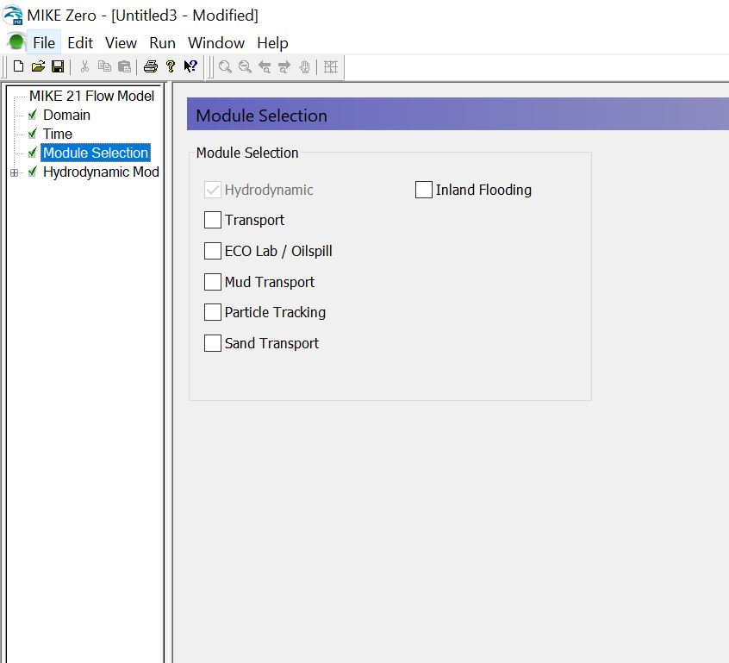
Then, move to the module selection
The “Hydrodynamic” module is already selected by default.
You could select the “Transport” for sediment transport simulation.
Eco Lab/ Oilspill is Water quality simulation.
In this tutorial we are only discussing about the Hydrodynamic to give a basic concept about simulation in MIKE Zero.

Slide 15
In the same way, move to the tab one by one from the tree view and fill the parameters as the following slides. The given data are demo data.

Slide 16
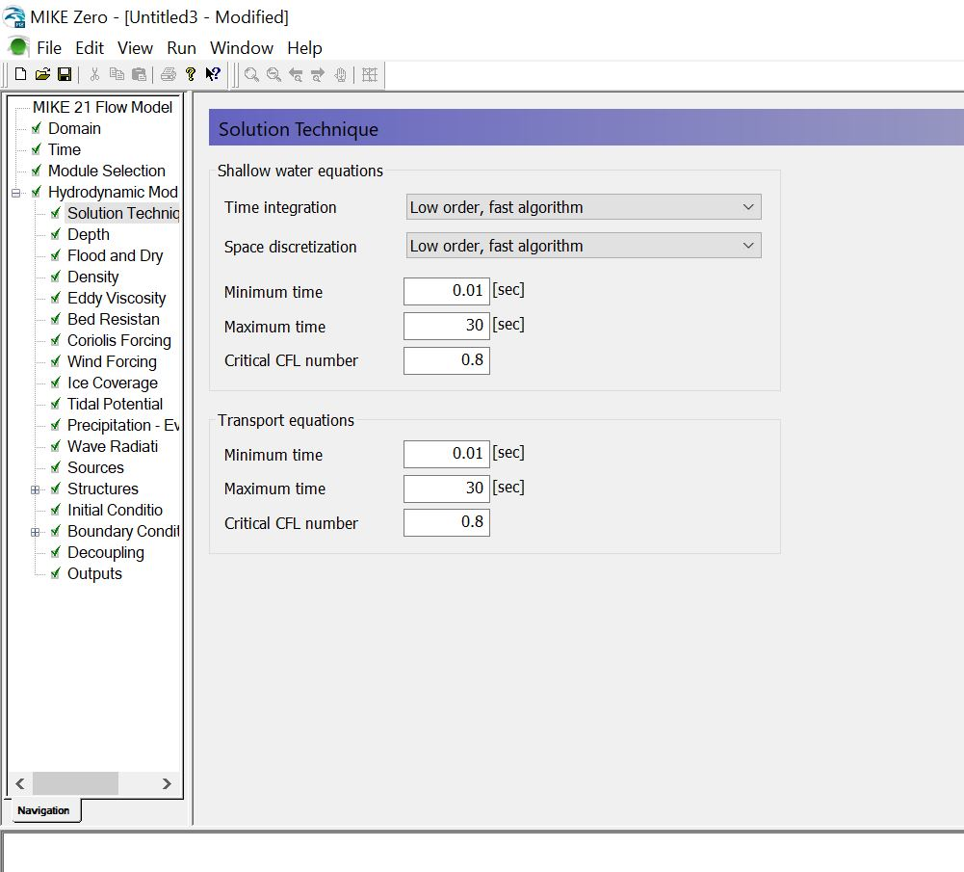

Slide 17
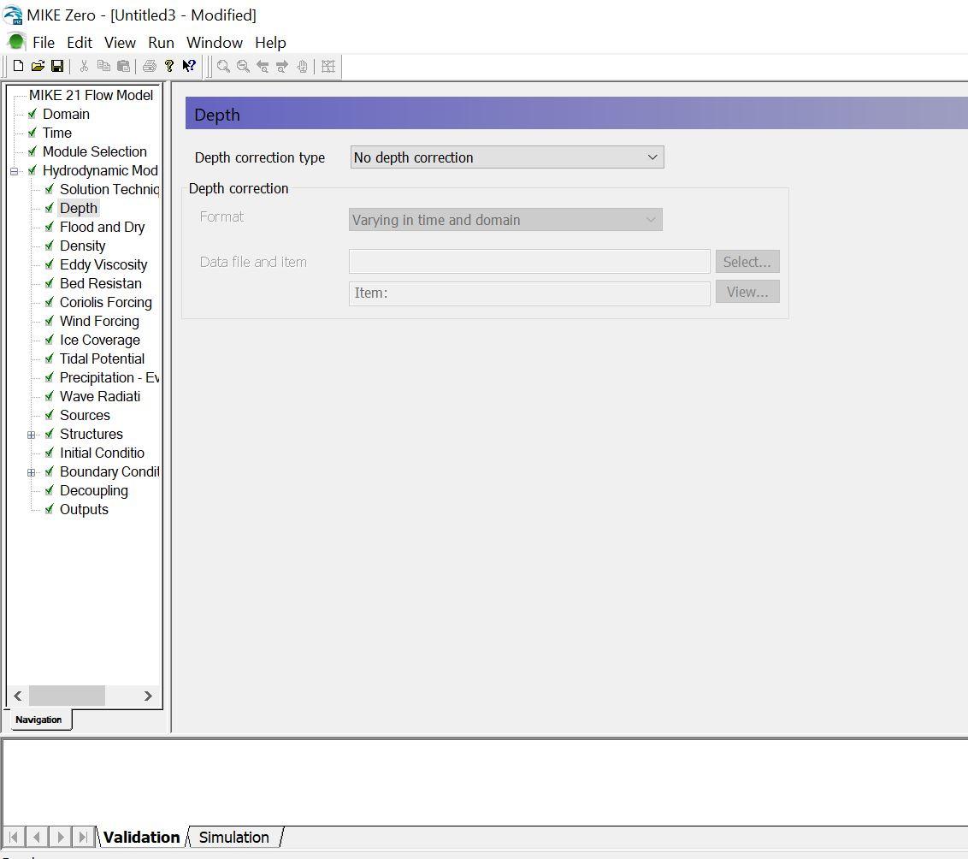

Slide 18
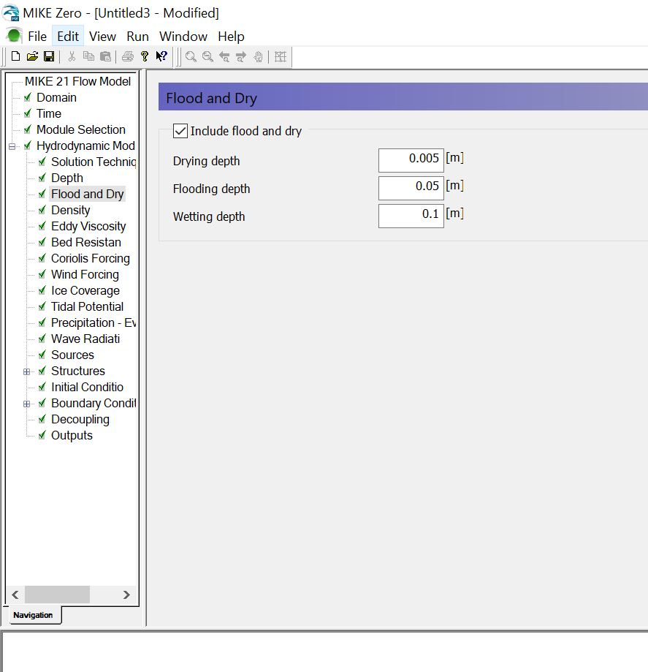

Slide 19
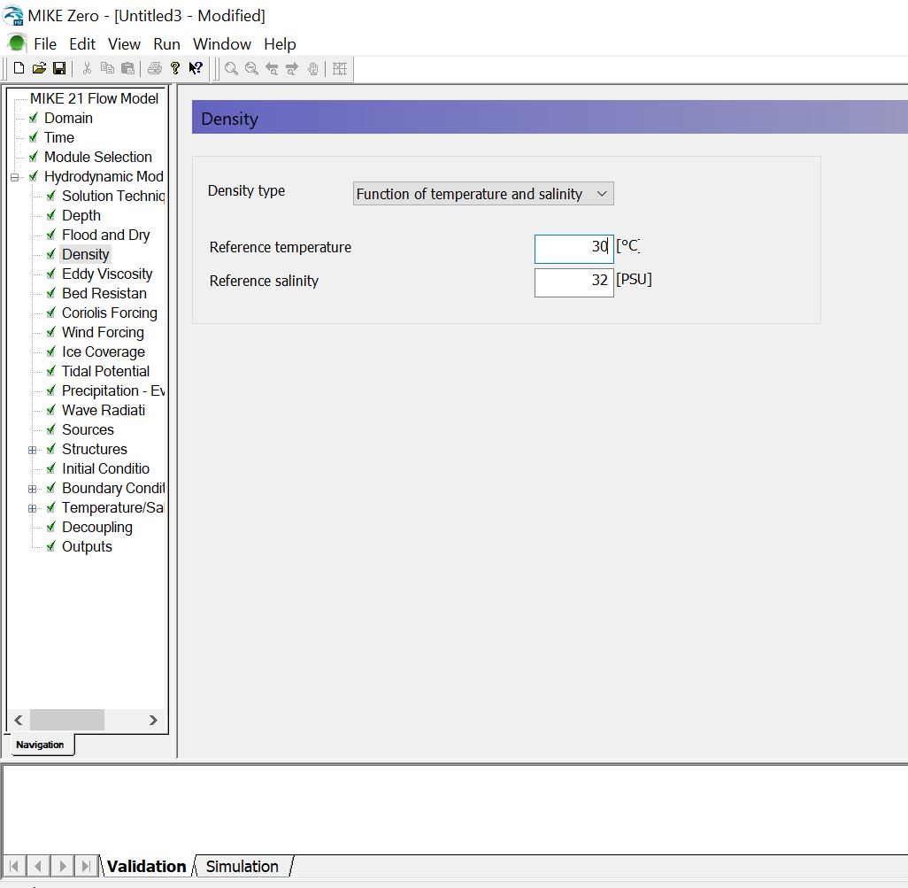

Slide 20
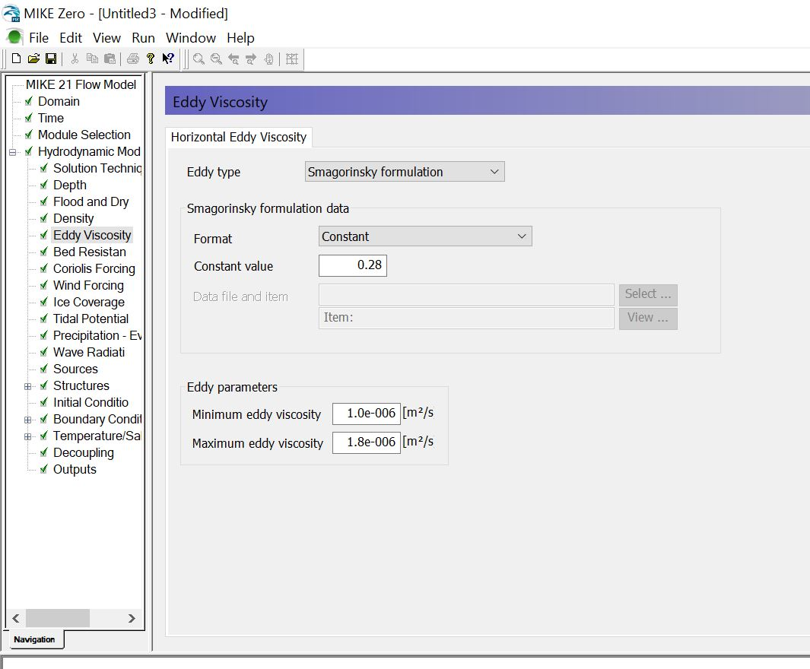

Slide 21
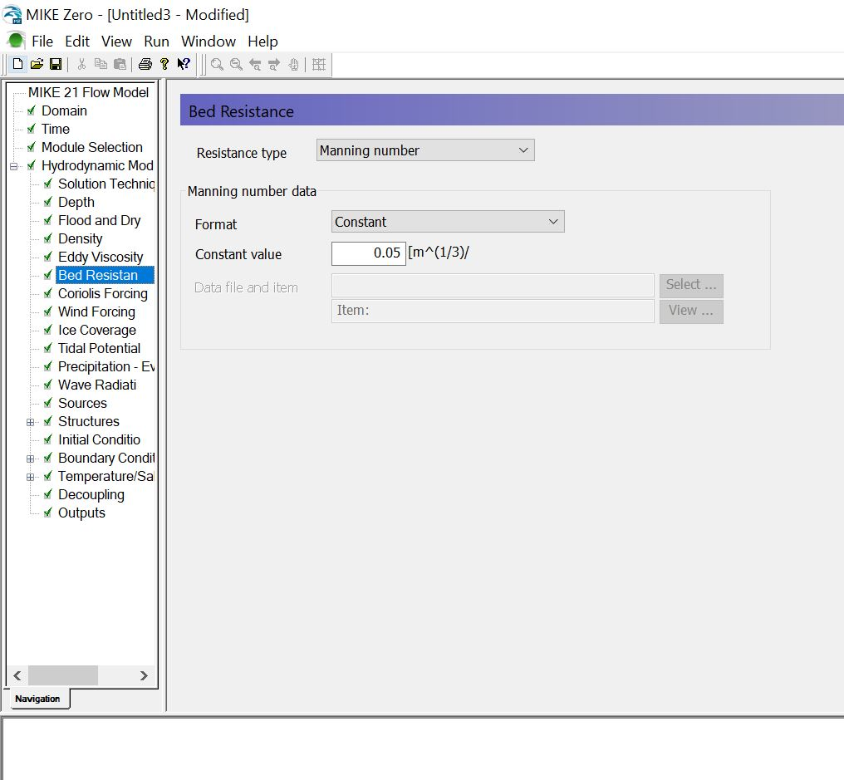

Slide 22
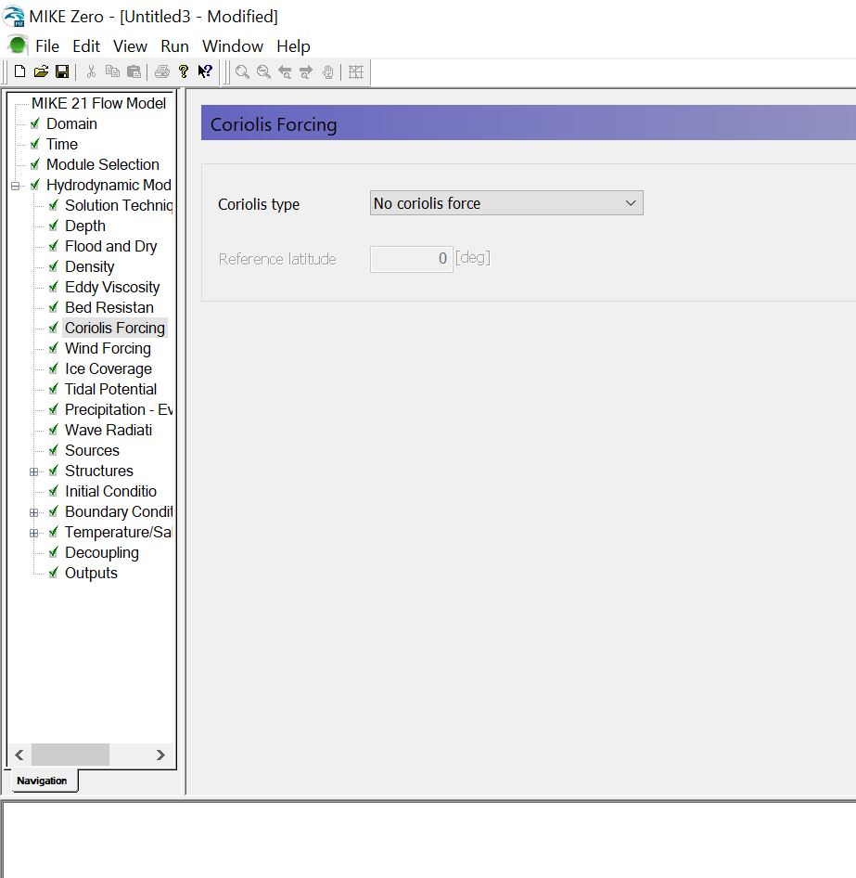

Slide 23
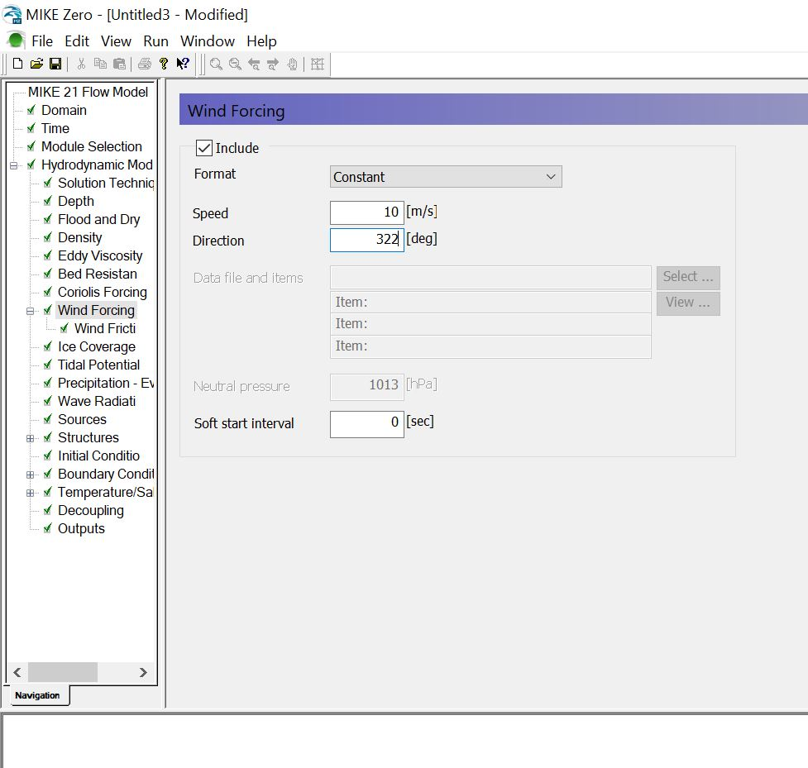

Slide 24
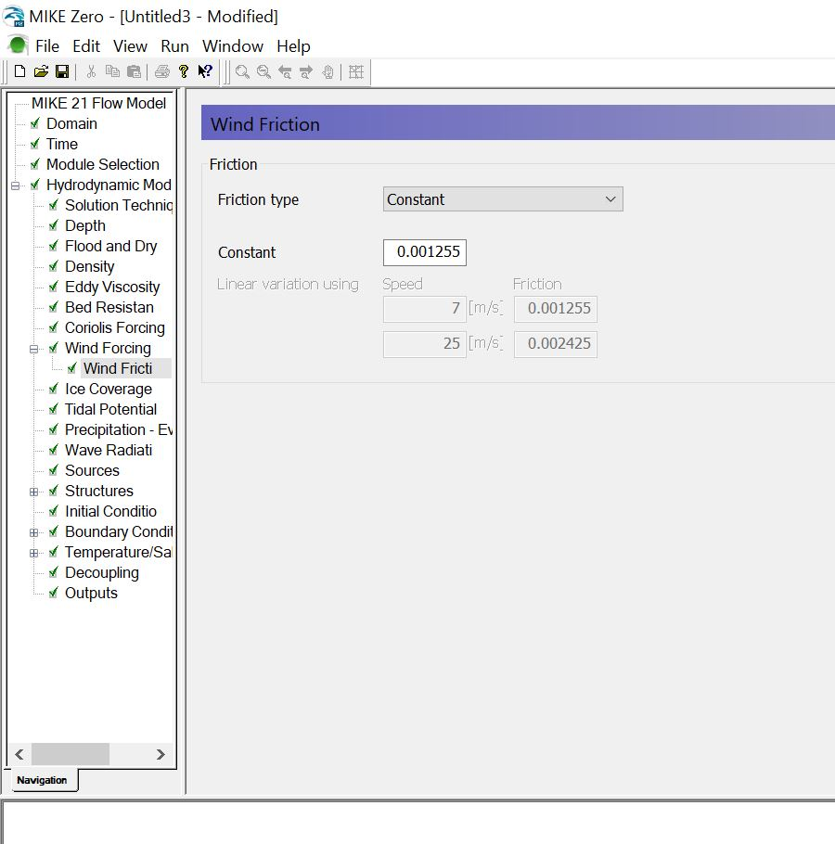

Slide 25
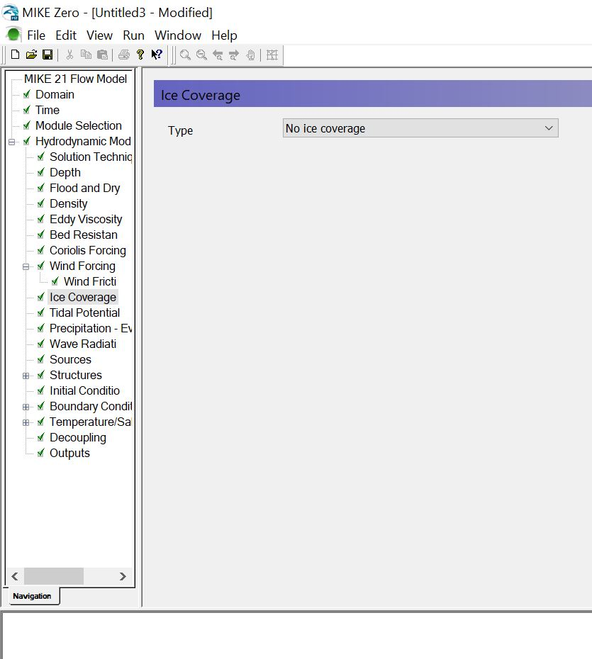

Slide 26
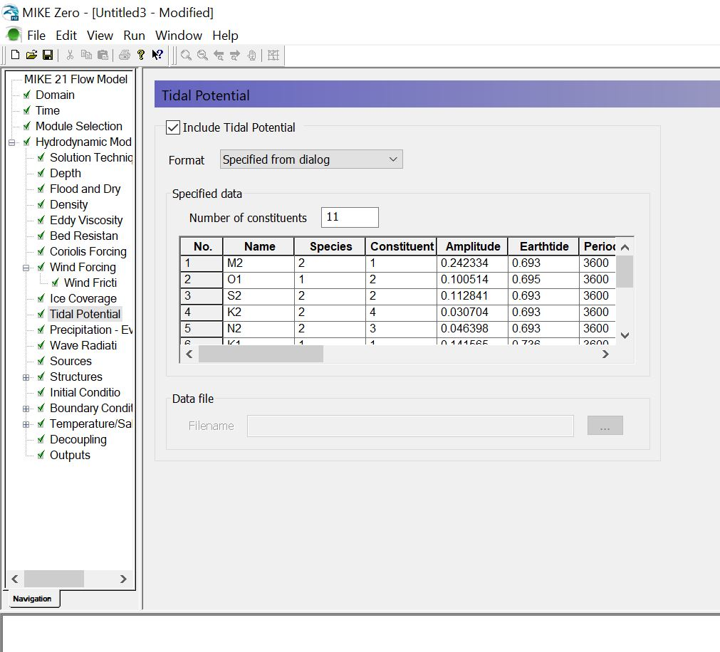

Slide 27
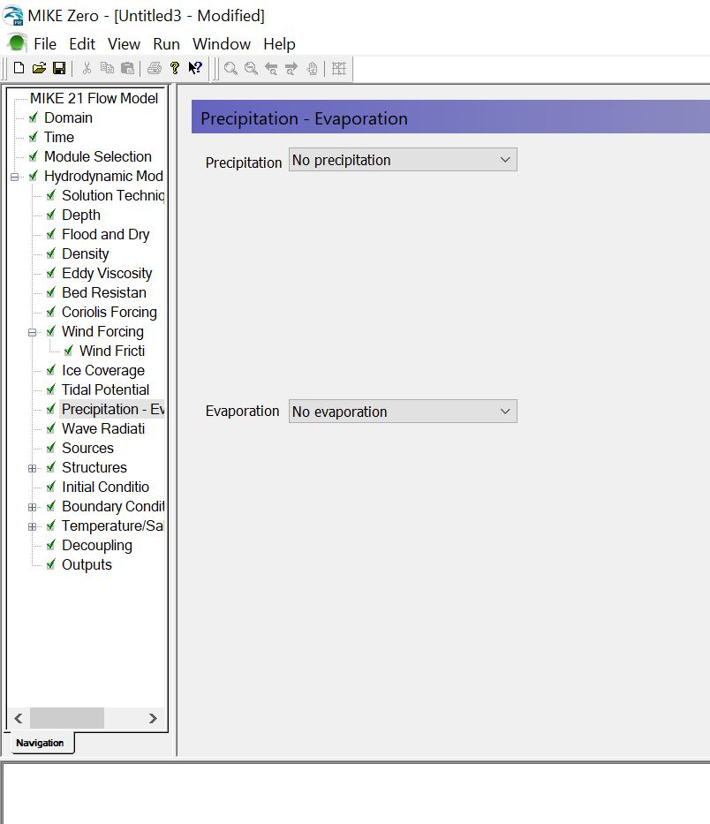

Slide 28
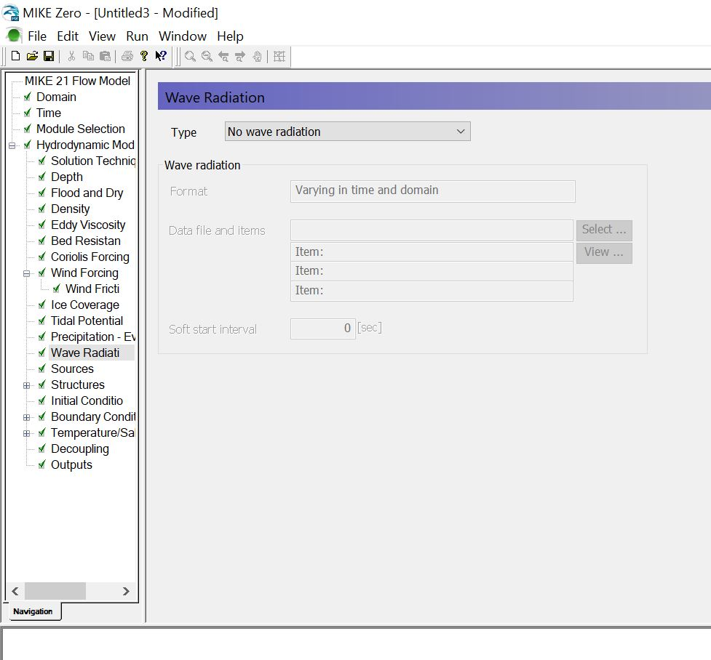

Slide 29
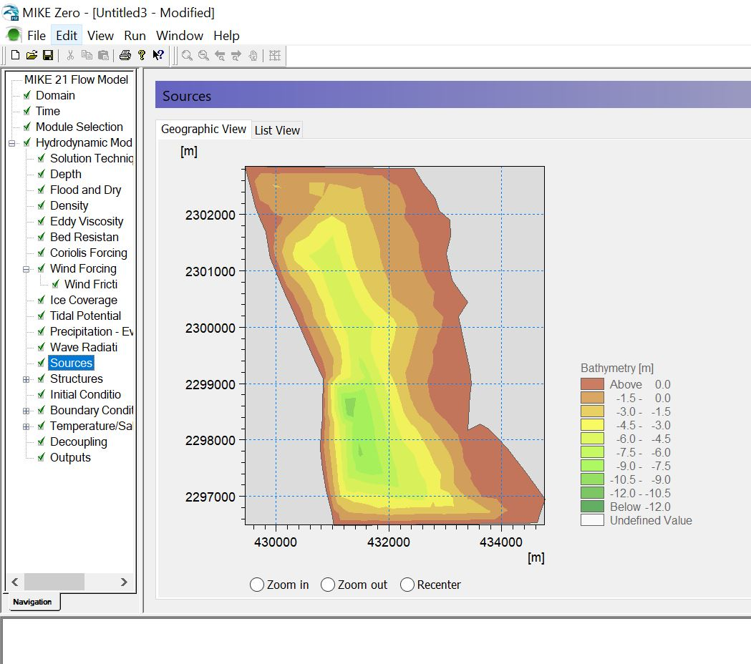

Slide 30
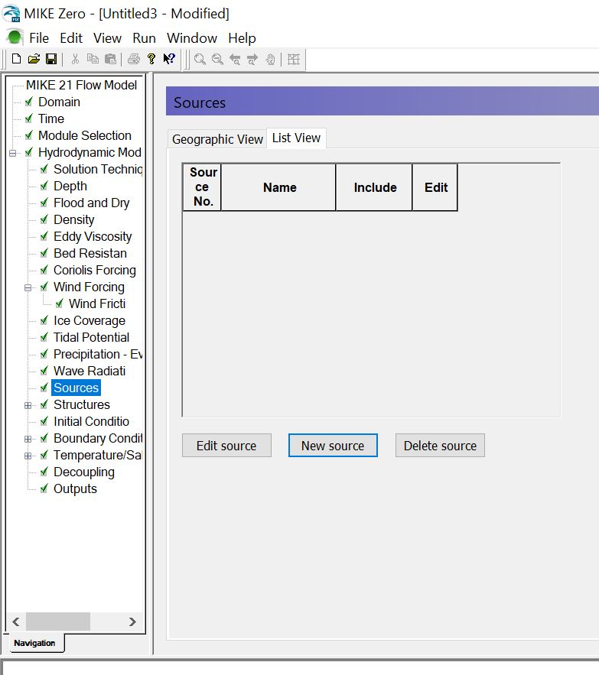

Slide 31
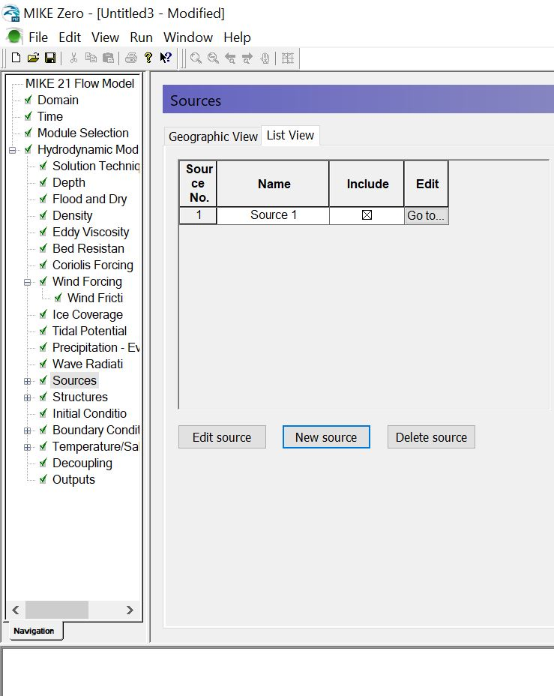

Slide 32
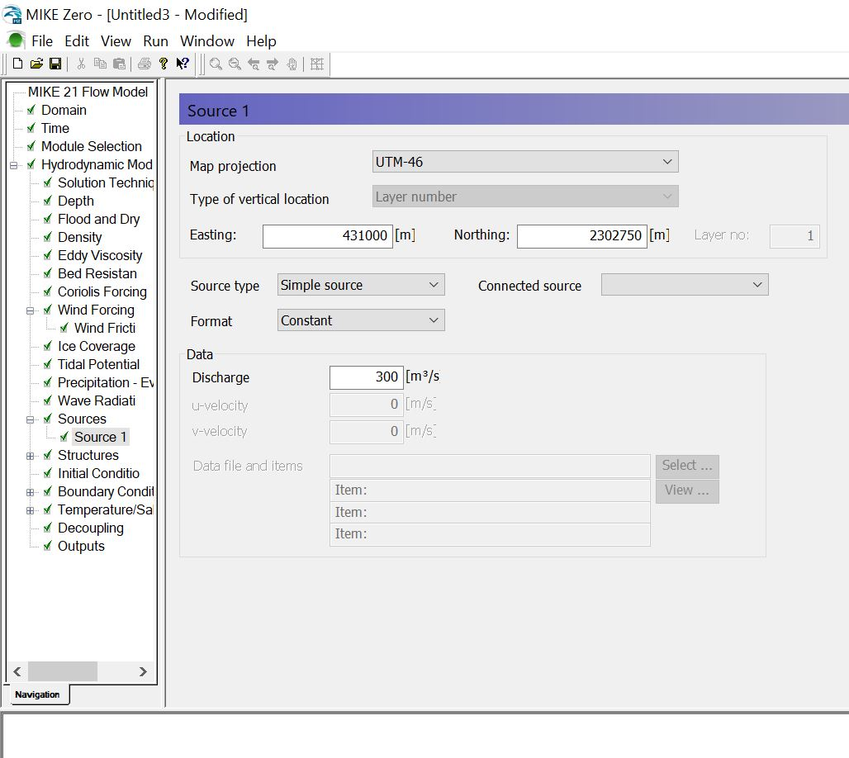

Slide 33
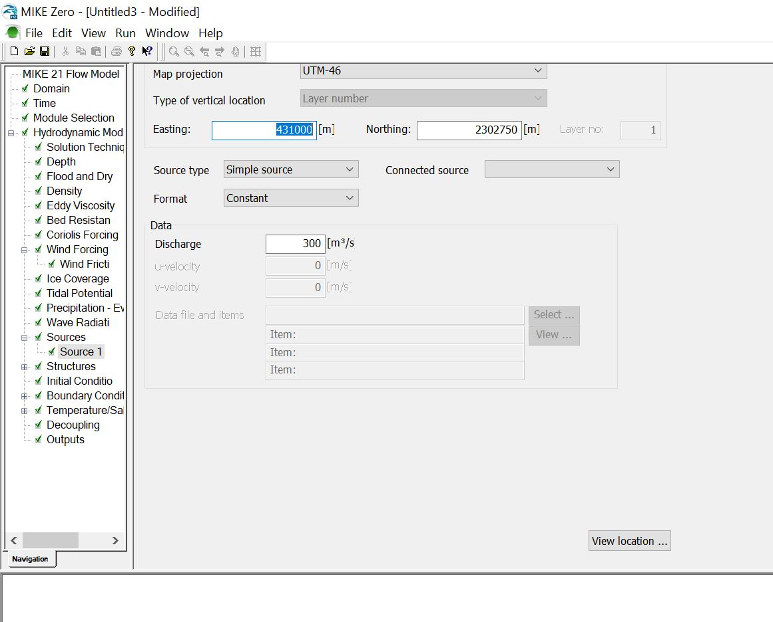

Slide 34
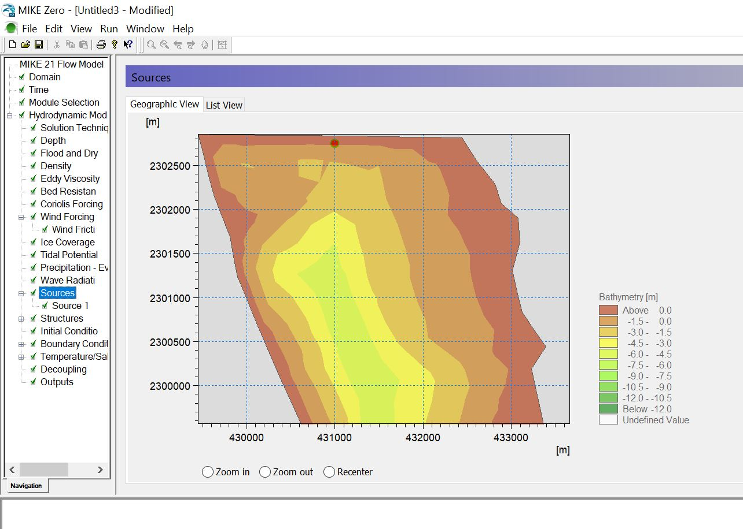
The easting and northing were set in a way that, the source would be located in the middle of the upstream side of the river. If there are more river branch, than you have to define each source for mouth of the river branch.

Slide 35
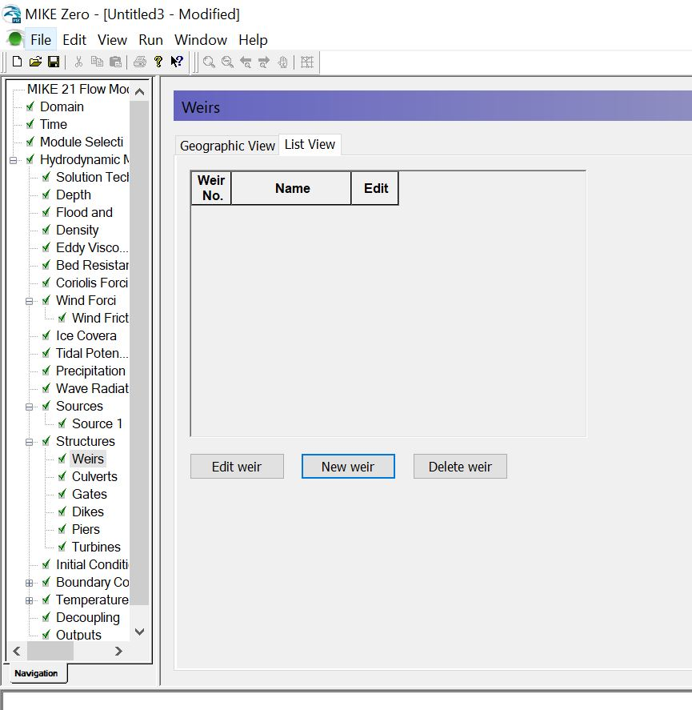

Slide 36
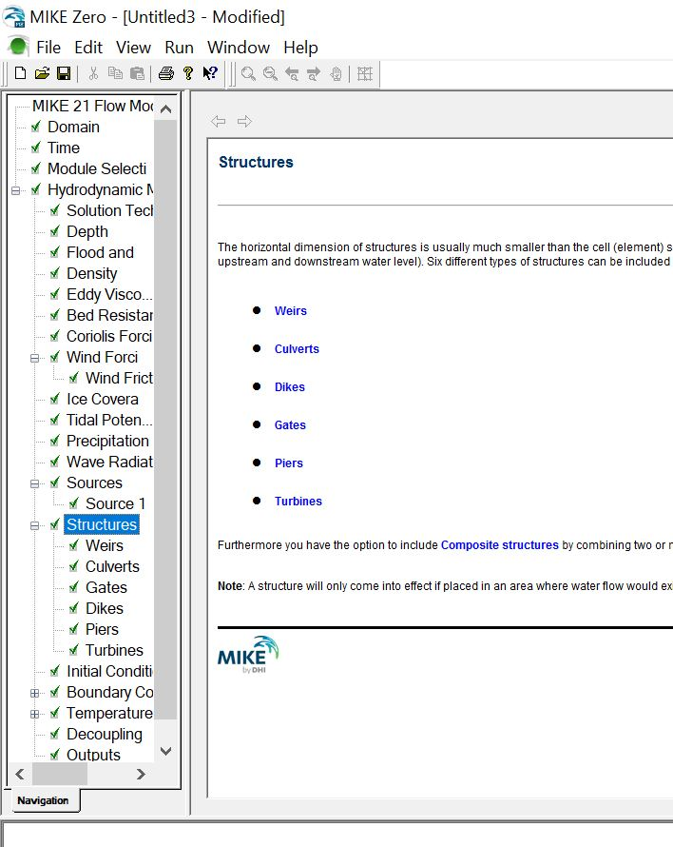

Slide 37
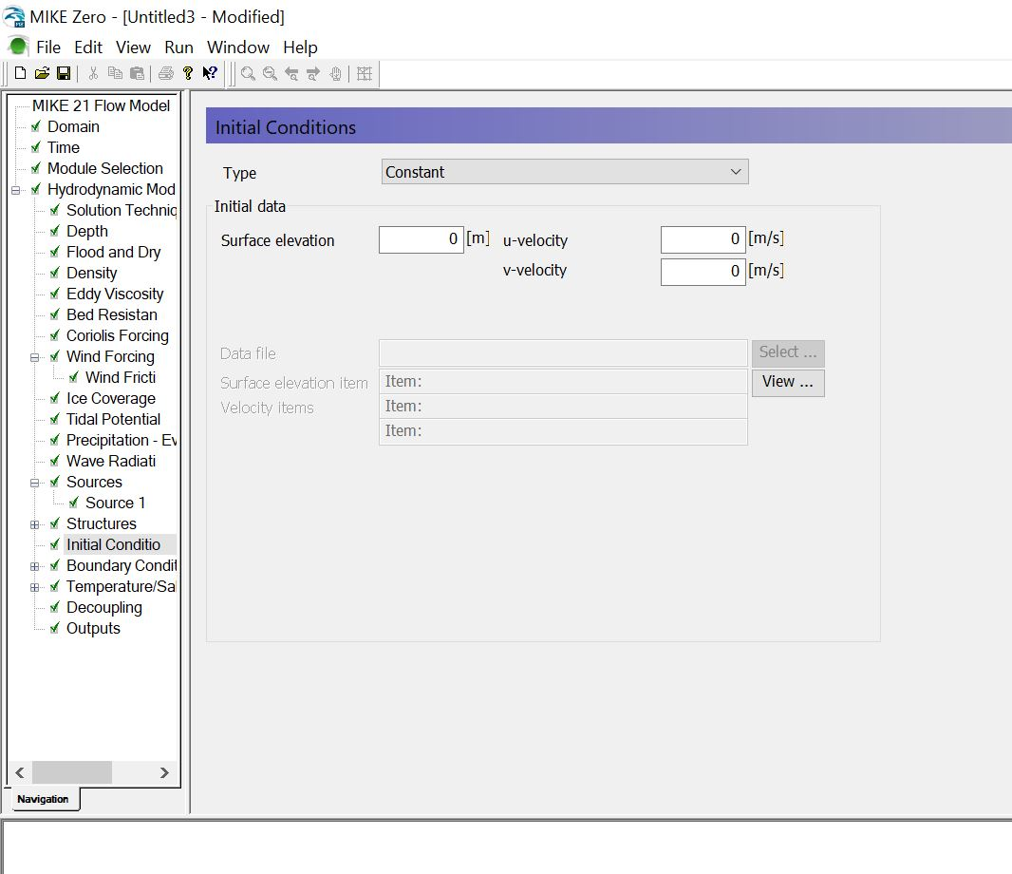

Slide 38
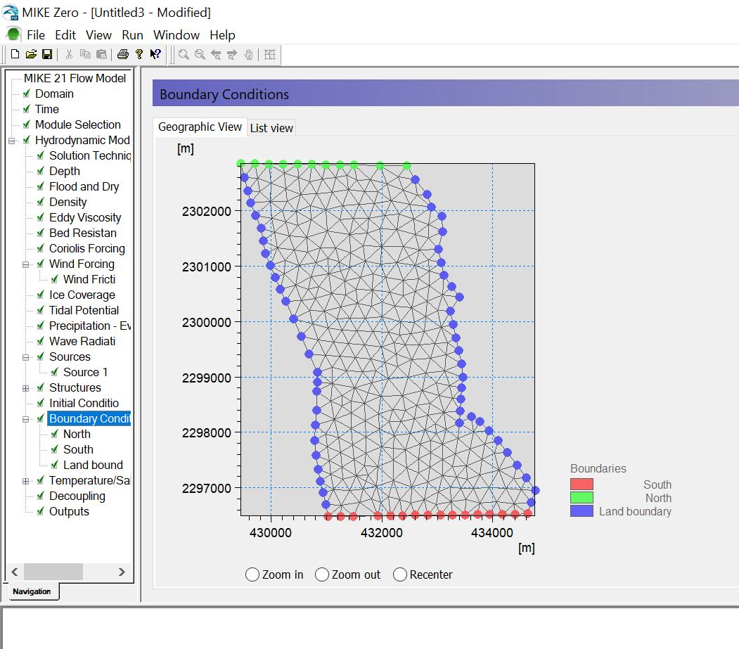

Slide 39
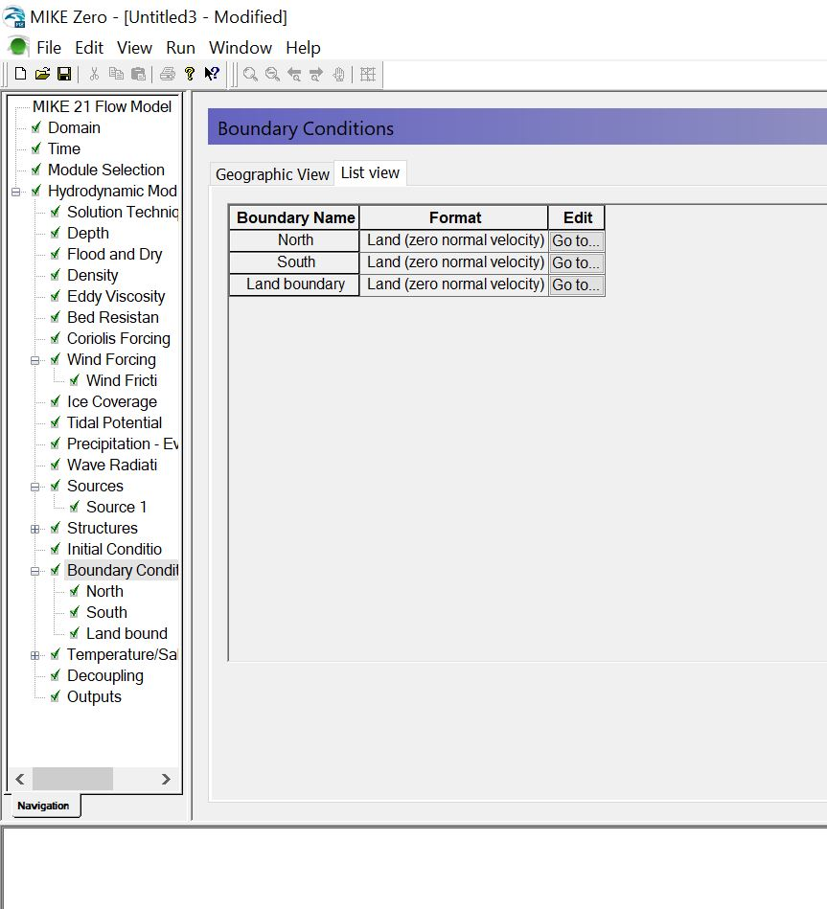

Slide 40
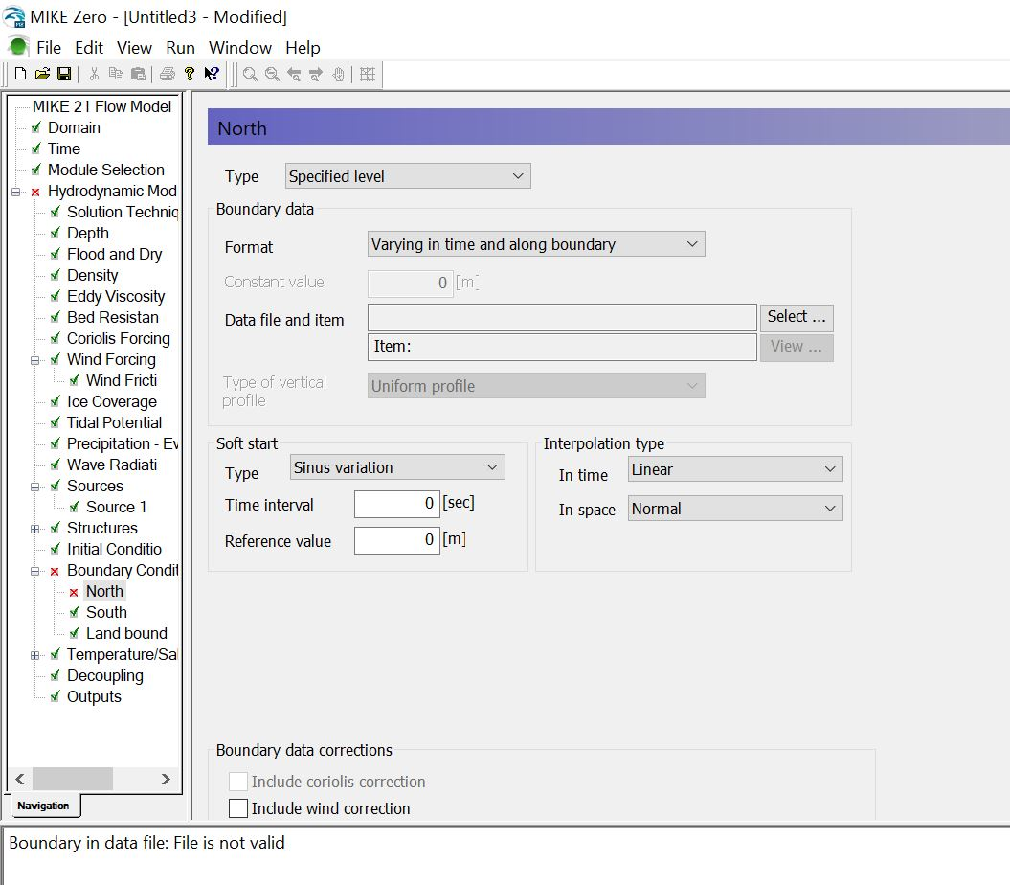
In the “Boundary Conditions”, we are going to import the Predicted tide data. If we select Type: Specified level and Format: Varying in time and along boundary, than we would be able to import the predicted tide for the north boundary by browsing using the “Select” button.

Slide 41
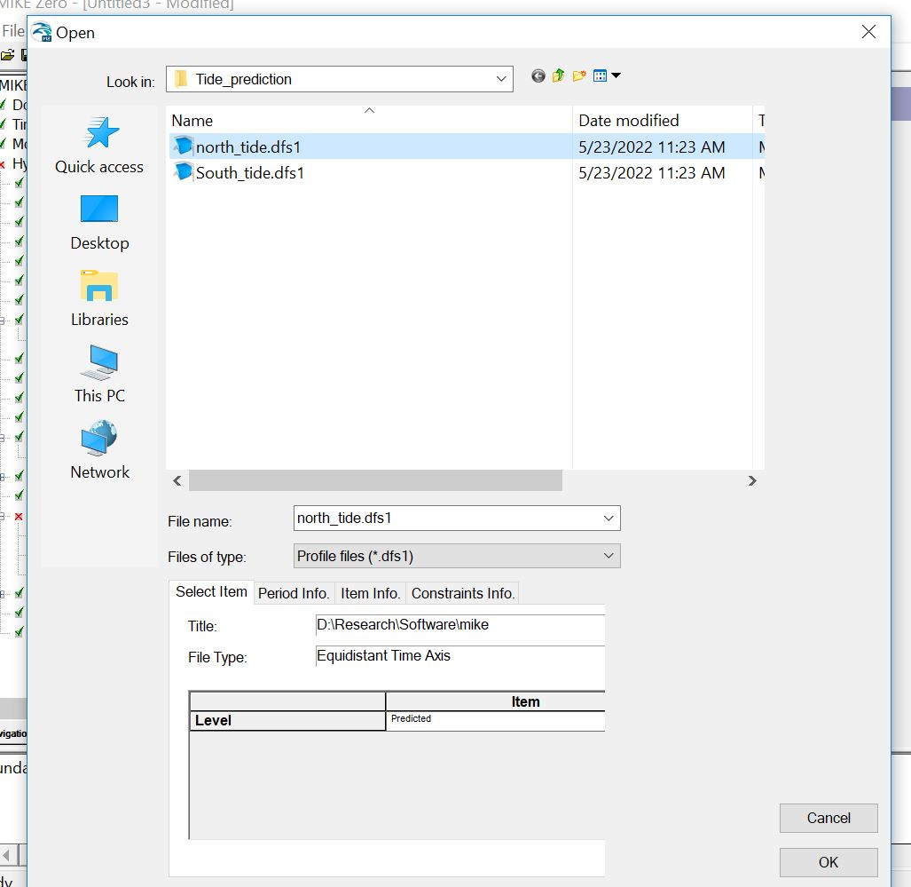

Slide 42
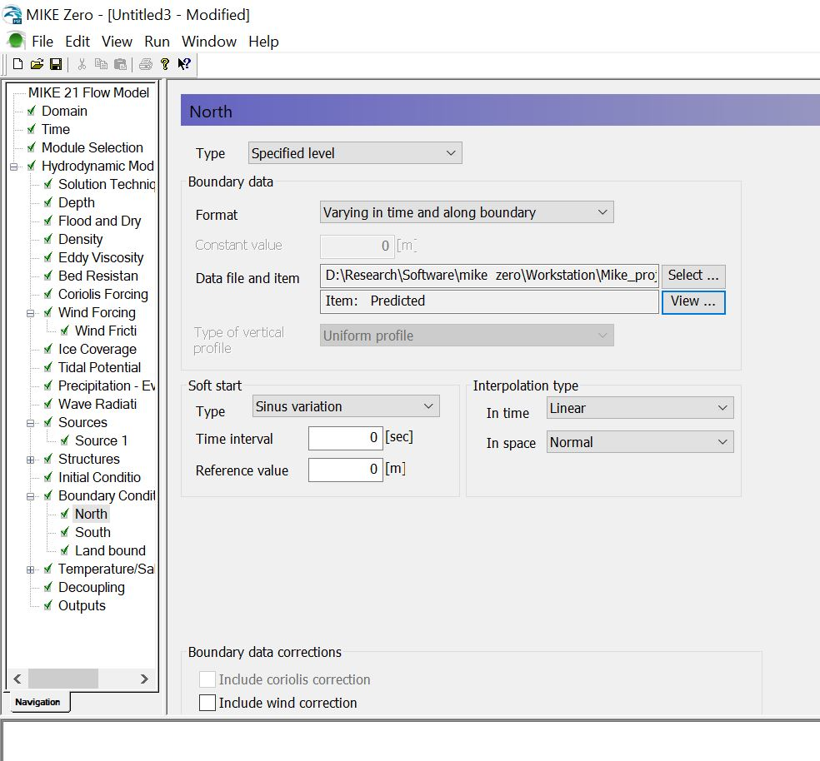
You can see the raw data of tide prediction by clicking “View” button

Slide 43
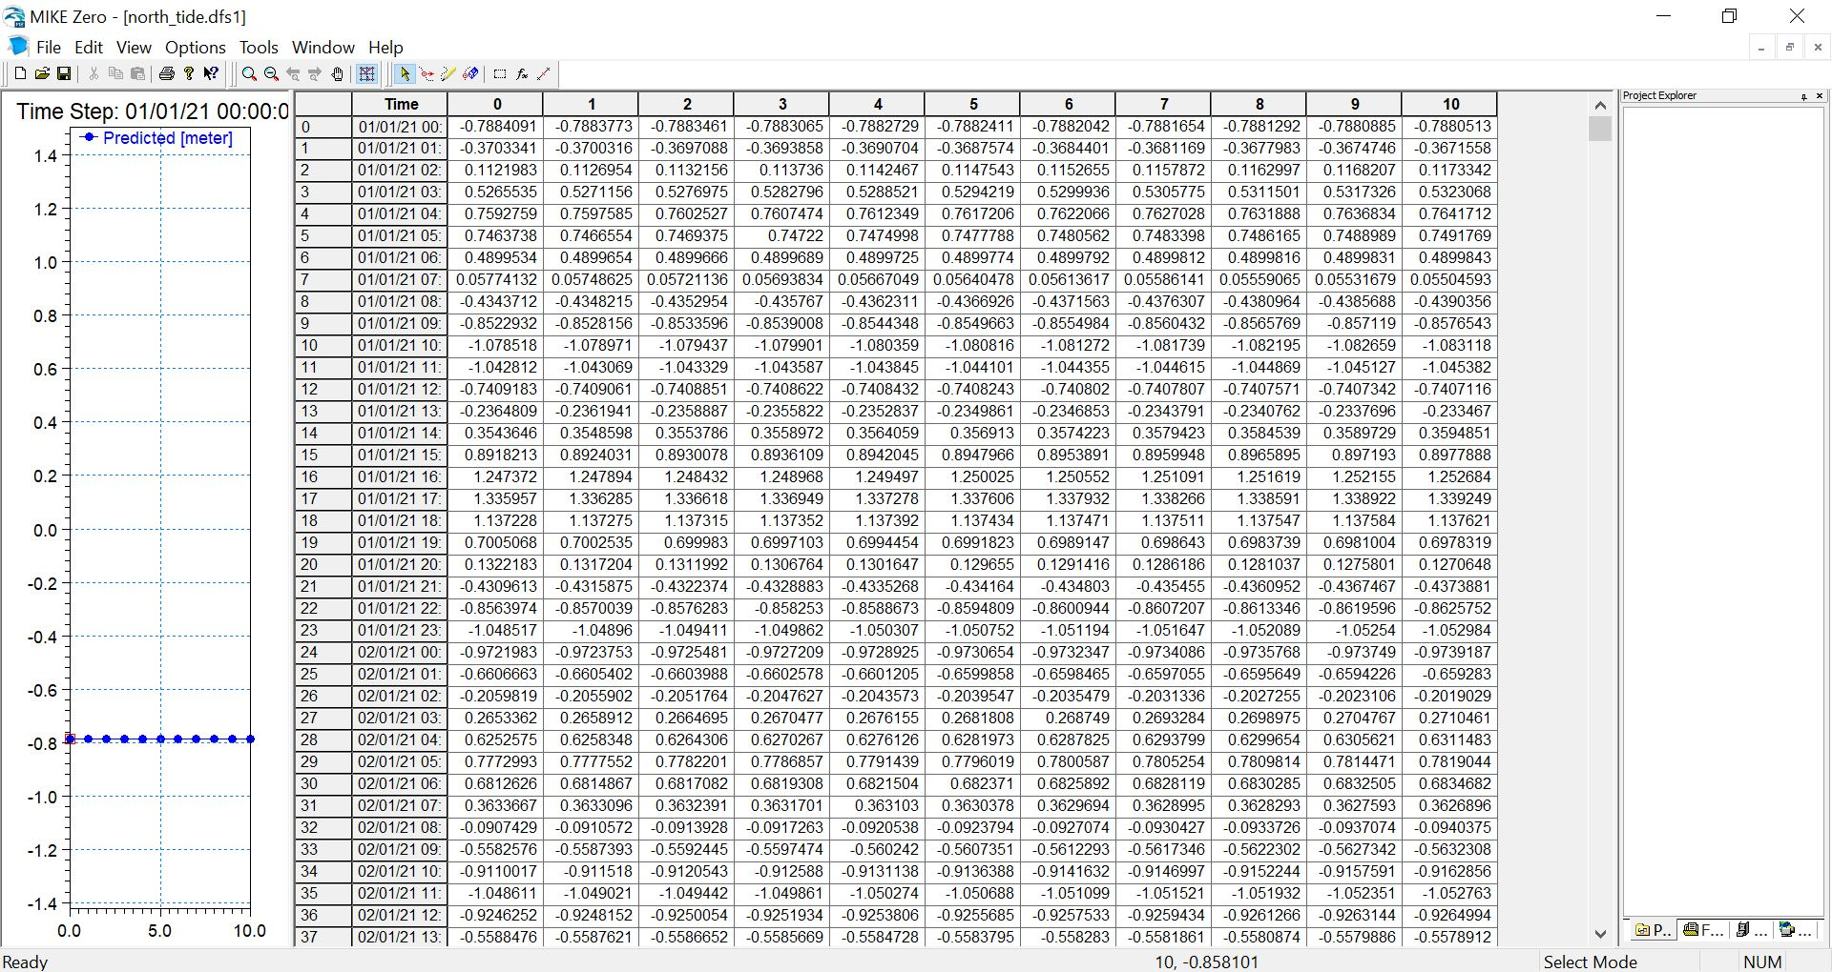
Tide Raw Data

Slide 44
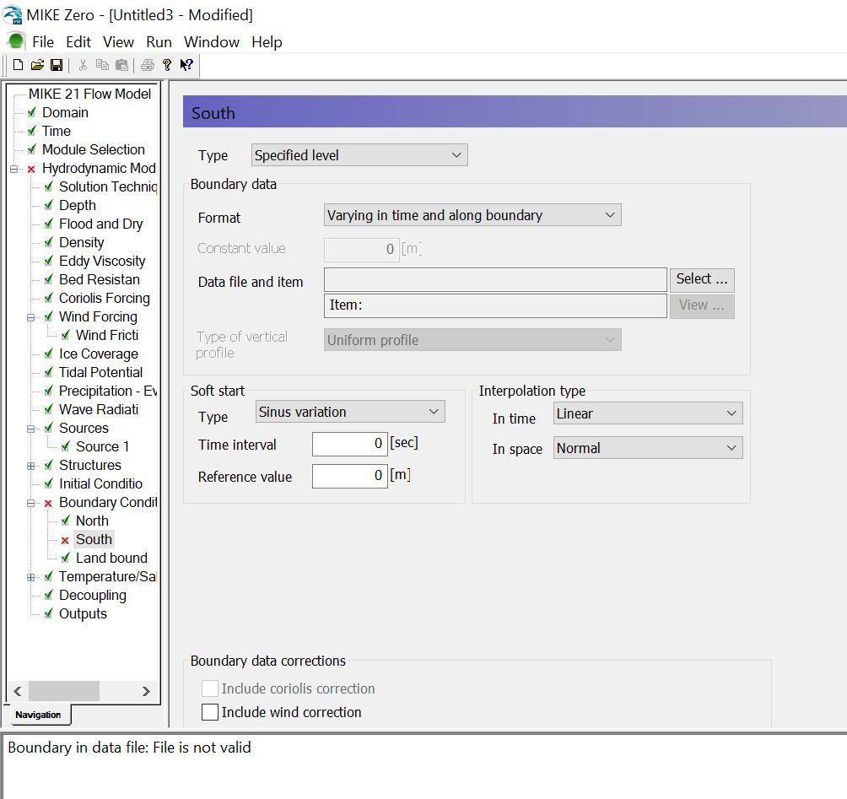

Slide 45
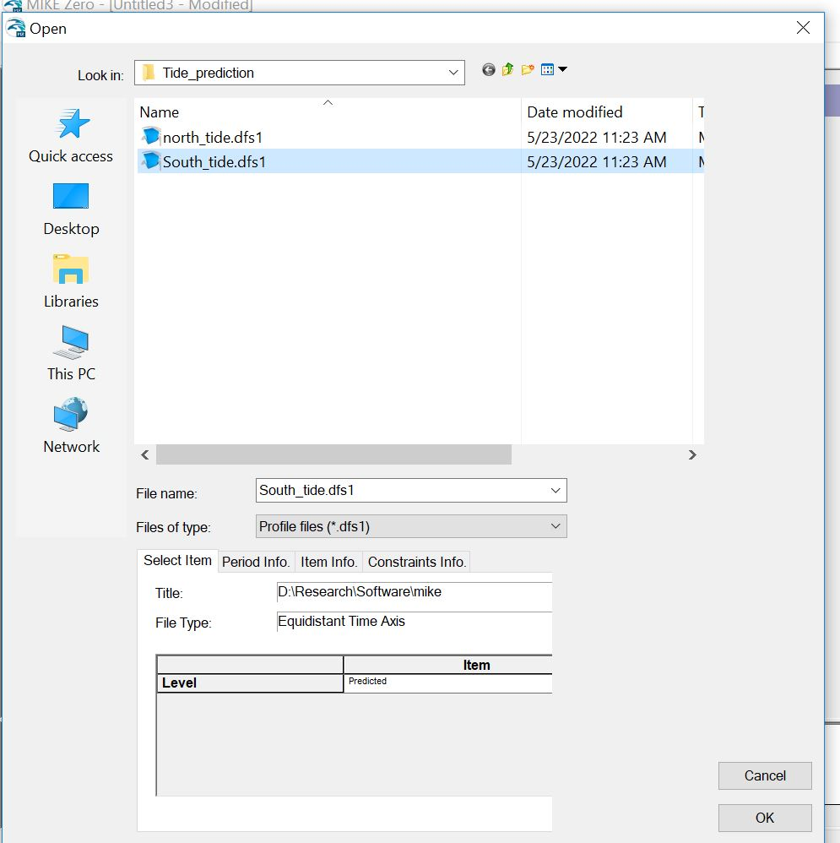

Slide 46
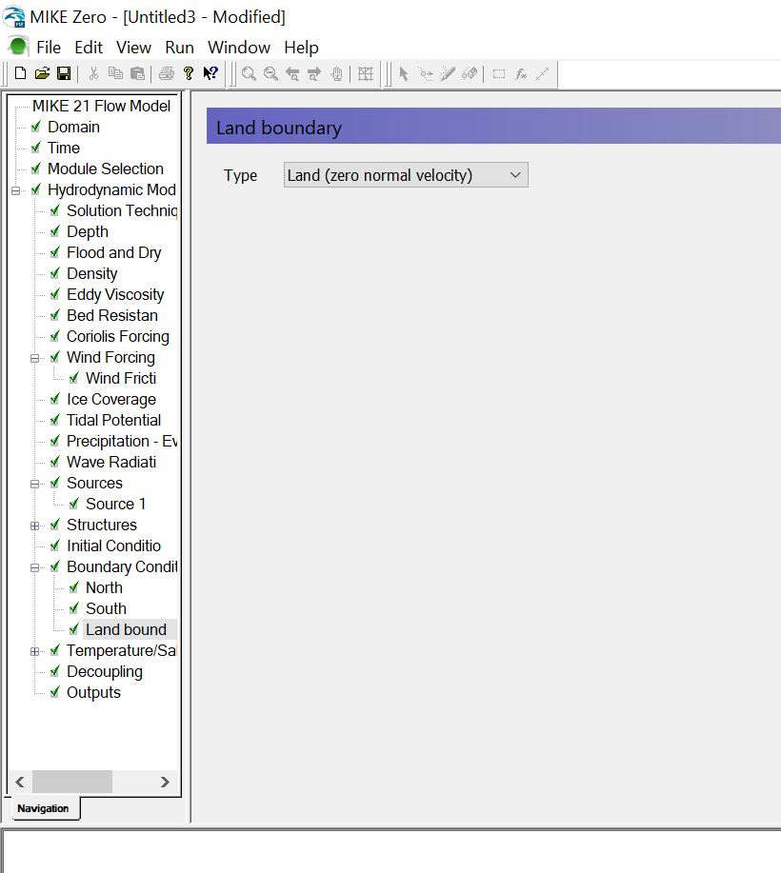

Slide 47
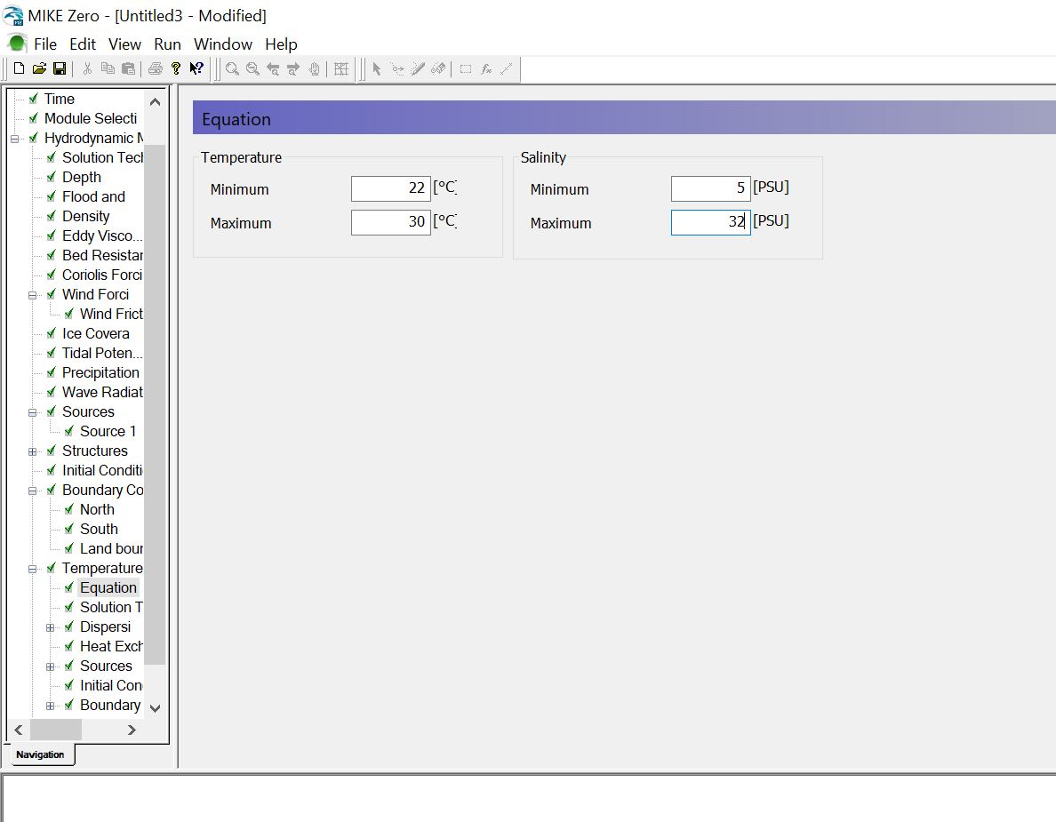

Slide 48
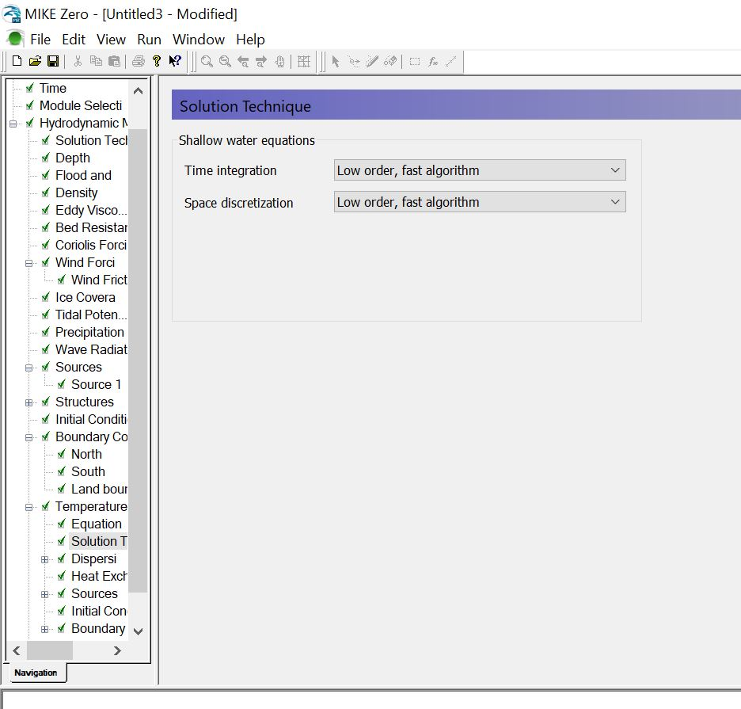

Slide 49
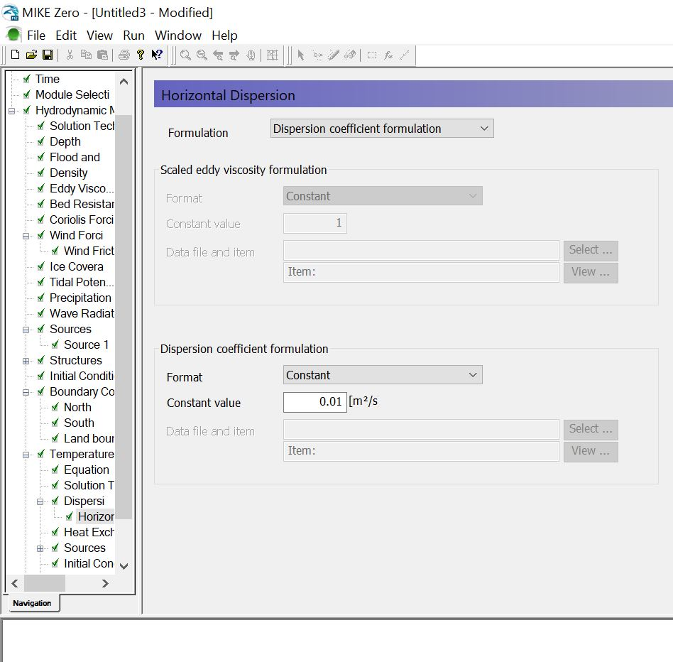

Slide 50
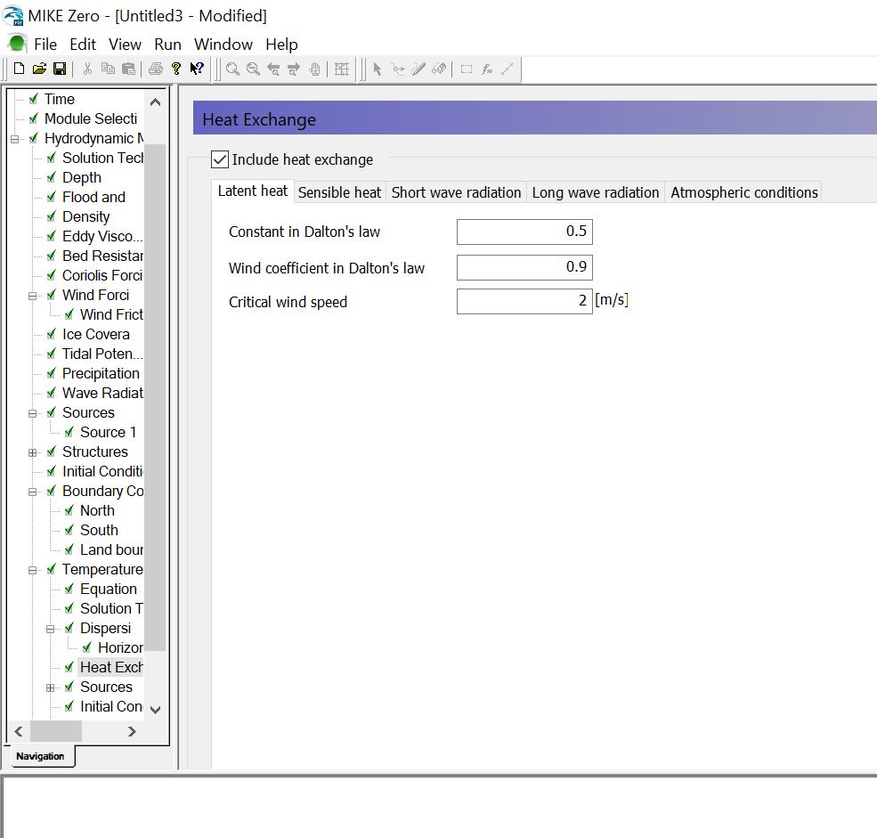

Slide 51
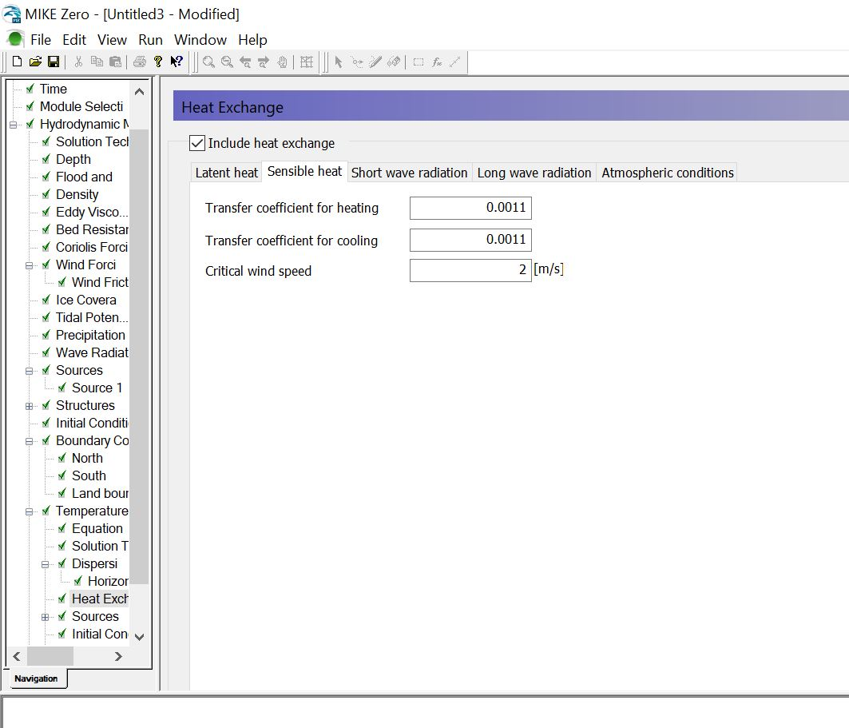

Slide 52
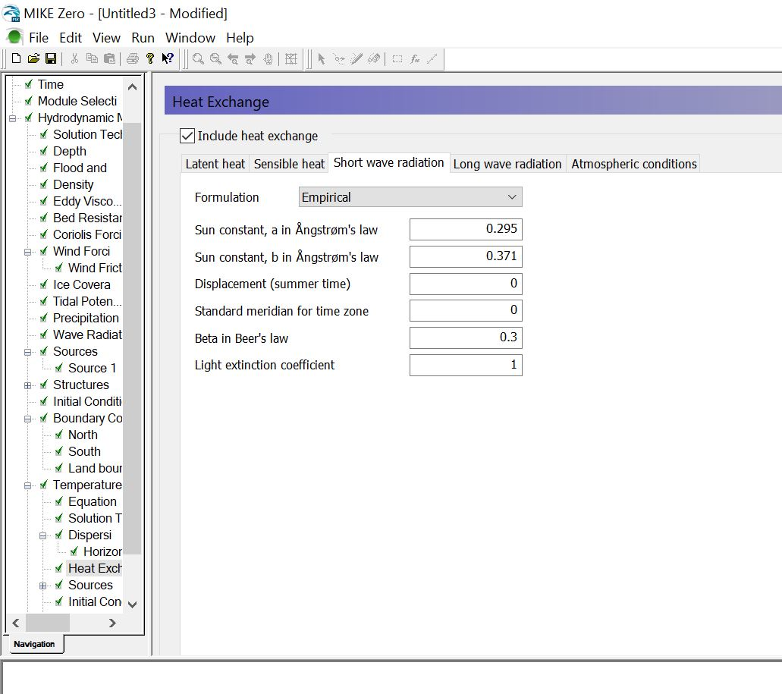

Slide 53
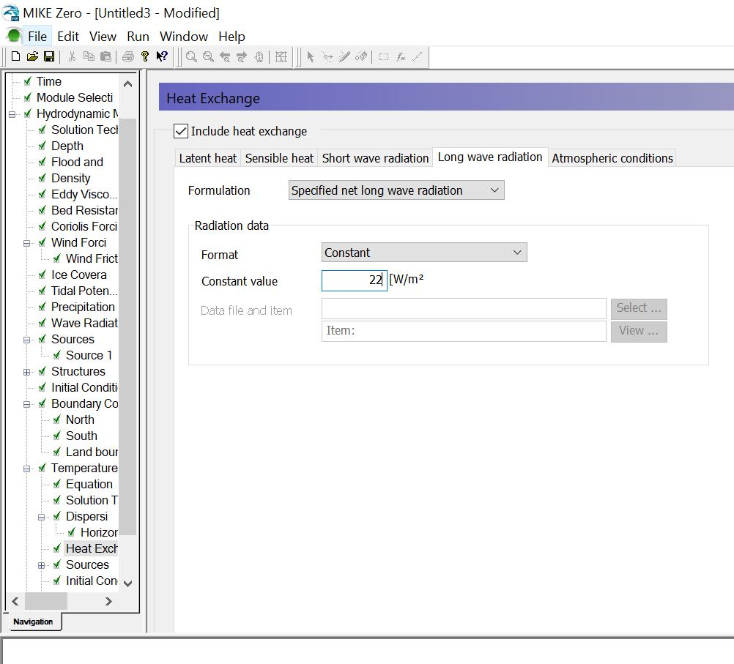

Slide 54
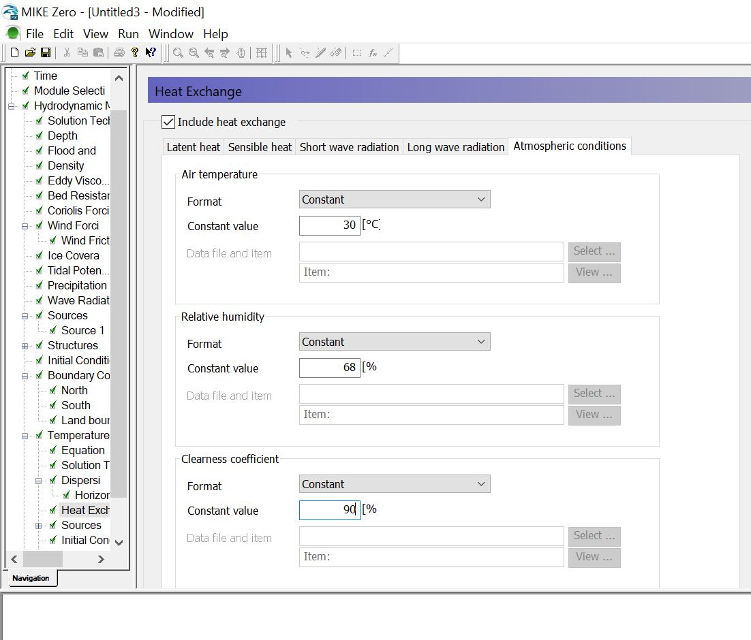

Slide 55


Slide 56


Slide 57


Slide 58


Slide 59


Slide 60


Slide 61


Slide 62


Slide 63

The cross will be removed after filling the value for every input of the Output 1 tab

Slide 64


Slide 65


Slide 66

Now, save the state file by navigating the File > Save as from the menu

Slide 67


Slide 68


Slide 69

Nothing was changed for now, just click OK.

Slide 70

Then, start the simulation by navigating:
Run > Start Simulation.
Simulation will be started.
If everything is OK, than “Normal run completion” status will be visible in the bottom of this window.

Slide 71

The simulation result will not be automatically opened. It is available in the result files folder.

Slide 72

The simulation result file is in *.dfsu file format

Slide 73

Don’t worry, it is not the only simulation result! You can run the animation of simulation result by clicking on play forward (marked in the red rectangle in the following figure)

Slide 74

Simulation result at time = 1

Slide 75


Slide 76


Slide 77


Slide 78


Slide 79
Simulation result at time = 360

Slide 80
Please note that, the data used in this simulation was just a demo. Please study scientific literature to collect the parameters and collect the field data (temperature, salinity, precipitation, evaporation rate, river discharge, wind speed and wind direction, did I miss anything?) to run the realistic simulation.
Also note that the same approach is applicable for the 3d simulation. Only you need to set the layer number in the “domain” tab. The output file would be 3D and volumetric.
The transport and Eco lab/Oilspill simulations would be roughly analogous to this simulation. The difference would be parameters.

Slide 81
THE END
THANK YOU

